Slide 1
1ST Semester Project
I am very thankful to Sir Sajjad and Sir Naeem Ahmed who helped me to learn the very first computer language in my life that is C++.
Because of them I am able to do coding and I made this project

Slide 2
Something About Project:
The title of my project is “easypaisa service”
Owing to the name this software contains almost all features which are included in the actual software (actual software belongs to Telenor company)
Note: dial *786# on your cell phone and see what happens

Slide 3
Features:
Strong Login System.
Filling is used.
It provides scenario of how actual software looks and its functions are doing same as actual software does like:
You can send money to bank account, mobile account, on your CNIC etc.
You can recharge your mobile balance.
You can pay your utility bills online.
You can make other payments like: pay challan, donation, pay fee, online ticket booking etc.

Slide 4
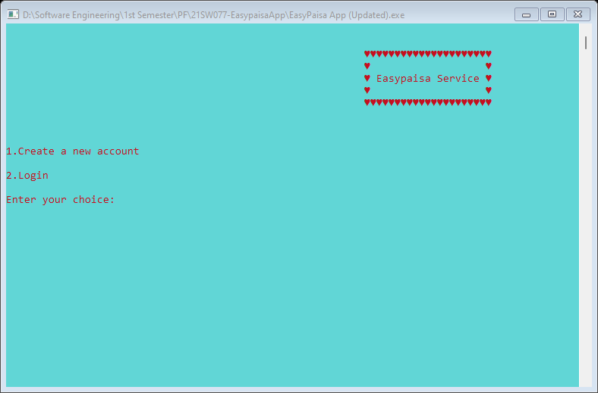

Slide 5
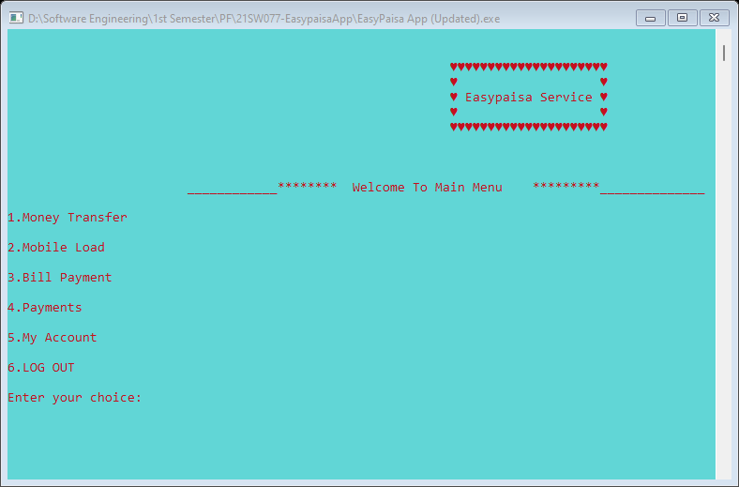

Slide 6
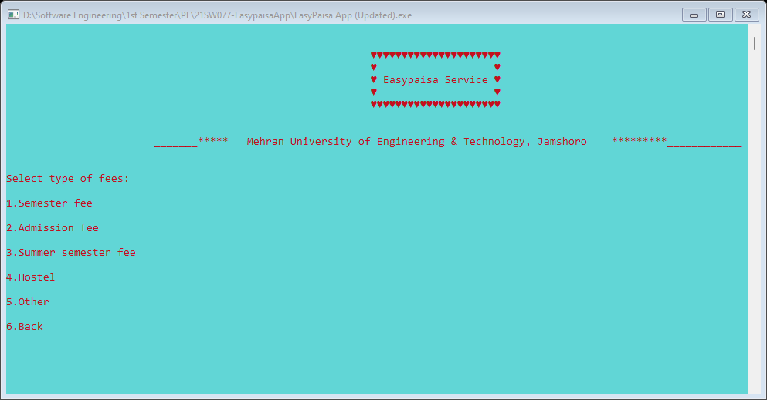

Slide 7
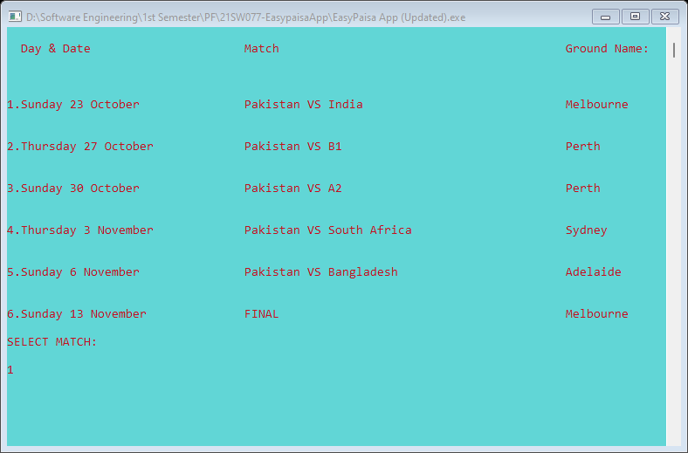

Slide 8
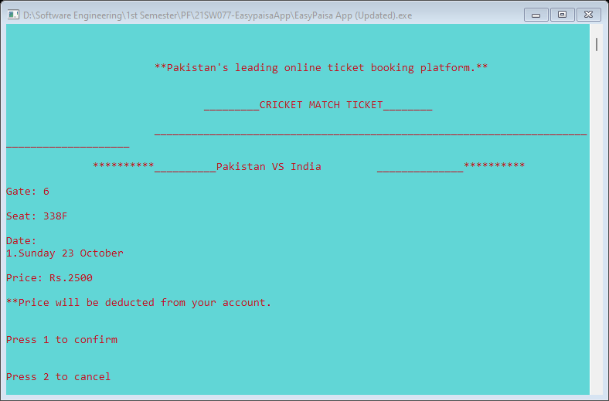

Slide 9
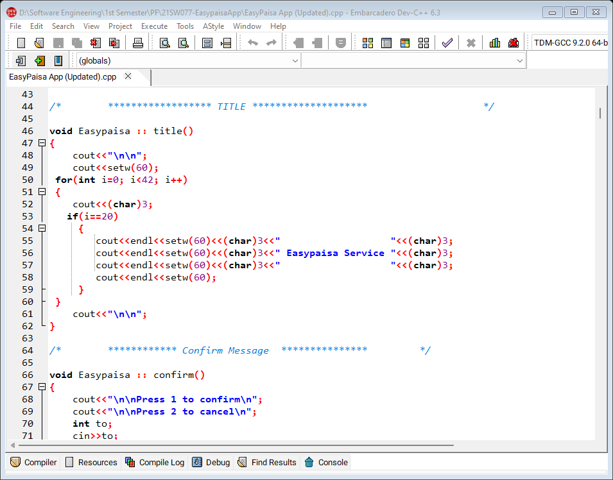

Slide 10
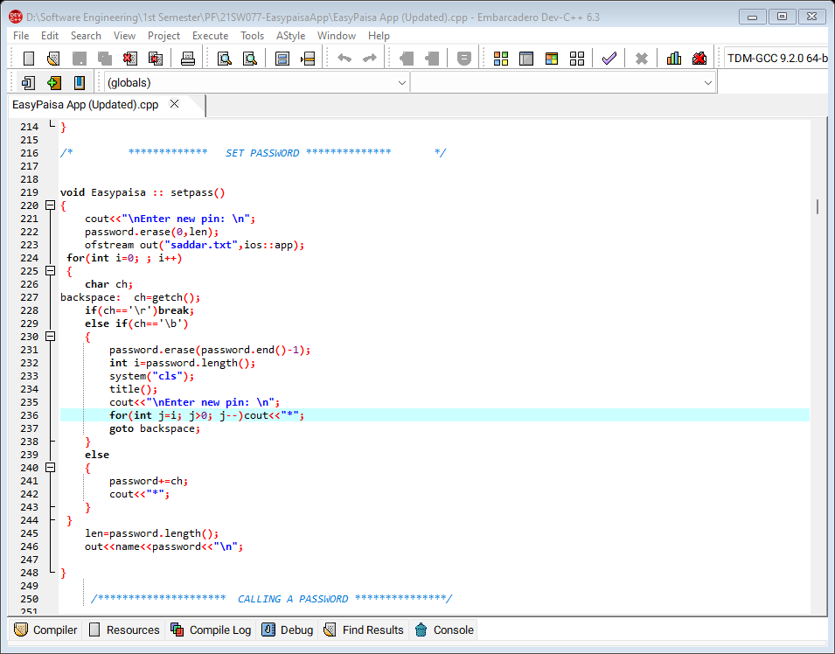

Slide 11
Did you notice that: The most difficult part of my project was making Login System in which making password took more time because it was to be done through filling.

